Slide 1
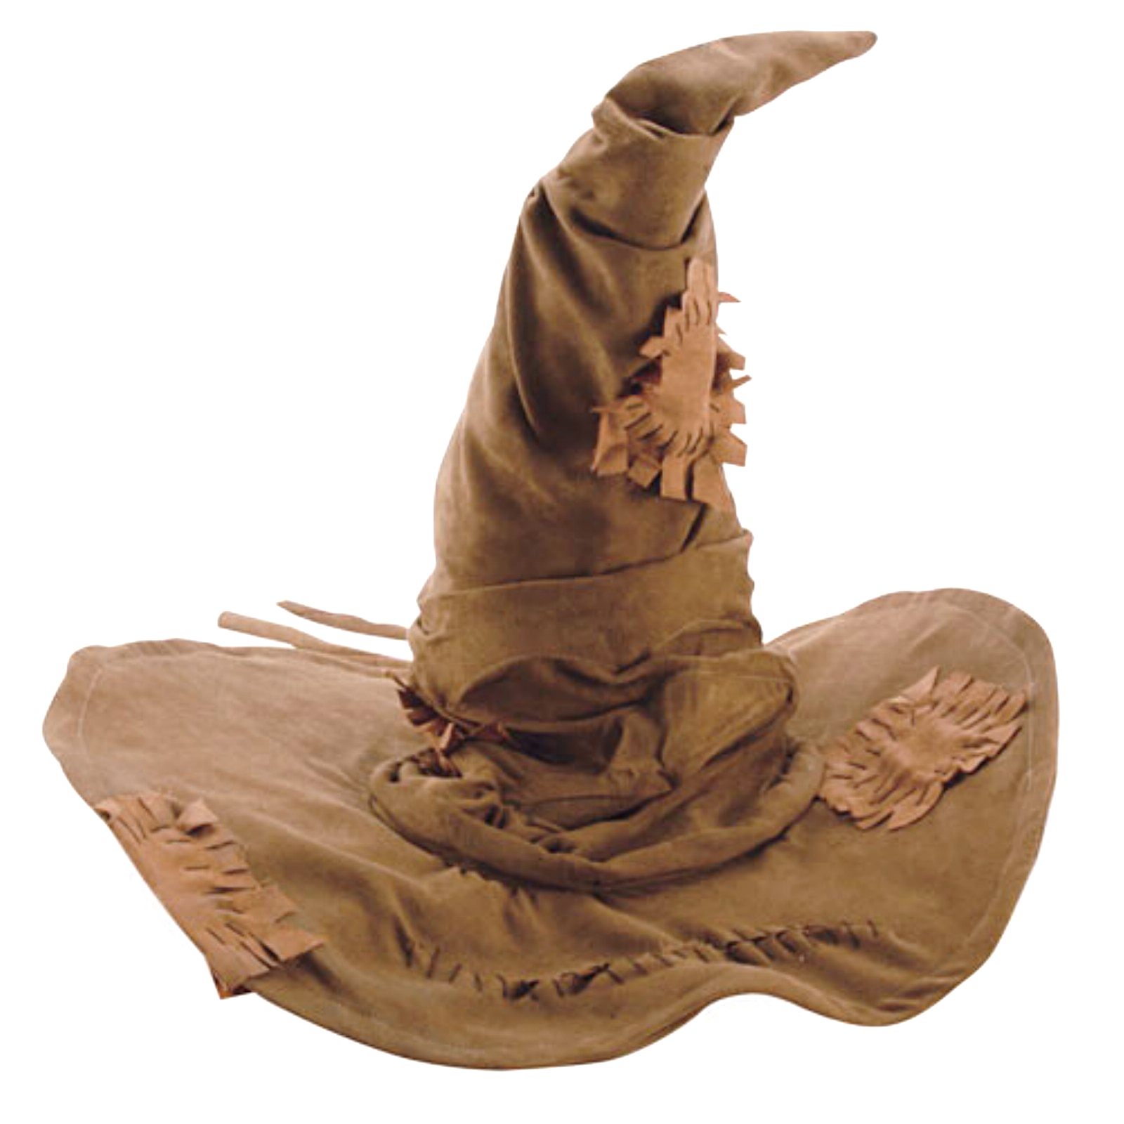

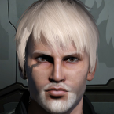

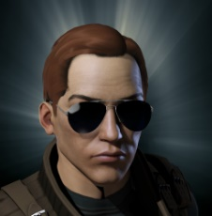
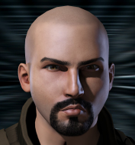
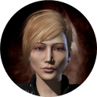
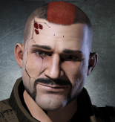

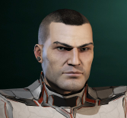


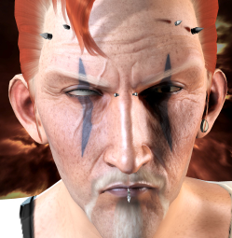
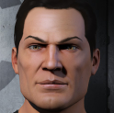
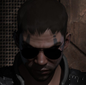
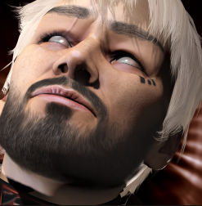

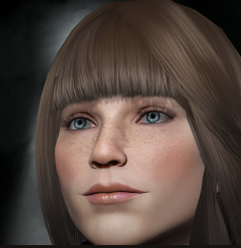

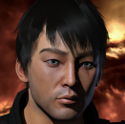



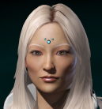
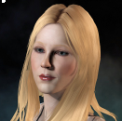
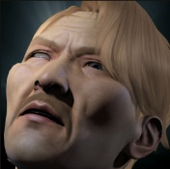
Brave Leadership Team
Okko Tolea
Logistics
Naverin Internal Affairs
TBD
Supply
?
Avend Avalhar
Finance & Infra Dir.
Algorthan Gaterau
People Director
Gepa Bow
Recruitment
?
TBD
Corp. Recruitment
Cond0mBurst
Moons
TBD
Industry
?
Sadism Evolved 2iC
Professor Push
Diplo Director
Dunk Dinkle Alliance CEO
Shattered Armer
Military Director
BeardyCheese
Chief of Staff
Teophanu Tivianne
Recon
Ariadne Invictus Alliance Chief of Staff
Rangvaldr
2iC
Tian Khamez
IT Director
Jana Halley & Jinx De’Caire
Dojo Co-Directors
Emeritus
Cagali Cagali
Yukiko Kami
Nancy Crow
n0rman
Notes:
Teophanu Tivianne

